Slide 1


LIVE AND LEARN
PHP 與 Redis 連線與應用

Slide 2
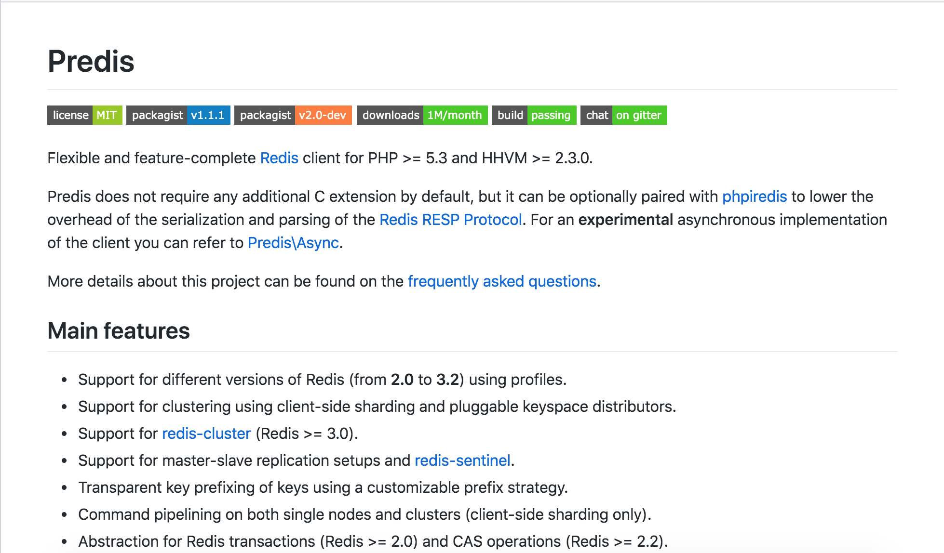
使用的套件
Predis： https://github.com/nrk/predis

Slide 3
安裝 php redis extension
sudo su
yum install –y gcc
cd ~
wget https://github.com/edtechd/phpredis/archive/php7.zip
yum install zip unzip -y
unzip php7.zip
cd phpredis-php7
/usr/bin/phpize
./configure --with-php-config=/usr/bin/php-config
make && make install
/etc/php.ini 新增 extension=redis.so

Slide 4
安裝下載 Predis
git clone git://github.com/nrk/predis.git

Slide 5
連線到 Redis
(connectRedis.php)
require "predis/autoload.php";
Predis\Autoloader::register();
try {
$redis = new Predis\Client(array(
"scheme" => "tcp",
"host" => "testshahow.xgsfji.0001.apne1.cache.amazonaws.com",
"port" => 6379));
echo "Successfully connected to Redis";
}
catch (Exception $e) {
echo "Couldn't connected to Redis";
echo $e->getMessage();
}

Slide 6
新增資料到 Redis
(storeToRedis.php)
$redis->set("hello_world", "Hi from php!");

Slide 7
刪除資料
(deleteToRedis.php)
$redis->del("hello_world");

